Slide 1

Empowering the Visually Impaired through AI ( VisionaryIQ )

Slide 2


About me
I am currently in Final year of my B.Tech in CSE-Data Science.
I am really passionate about Data science because it allows me to take data driven decisions and help me solve complex problems. As the saying goes “Data is the wealth” and I want to be a part of it.
I am currently an intern in Innomatics Research Labs, where I have been working on various data driven projects. Additionally I have done some courses related to Data Science and Artificial intelligence .
https://github.com/Harshavarma04/AMCAT-EDA
www.linkedin.com/in/harsha-vardhini04

Slide 3
Introduction
VisionaryIQ is an AI-based application designed to assist visually impaired individuals.
Key features:
Scene Description
Generation Text Extraction via OCR
Text-to-Speech Conversion

Slide 4
Key Features
🔍 Describe Scene: Provides a detailed description of the uploaded image.
📝 Extract Text: Extracts text from images using Optical Character Recognition (OCR).
🔊 Text-to-Speech: Converts extracted text to speech for auditory consumption.

Slide 5
Technologies Used
Tesseract OCR: For text extraction from images.
Google Gemini API: For generating scene descriptions.
pyttsx3: For converting text to speech.
Streamlit: For building the web interface.
Pycharm : To write the code.

Slide 6
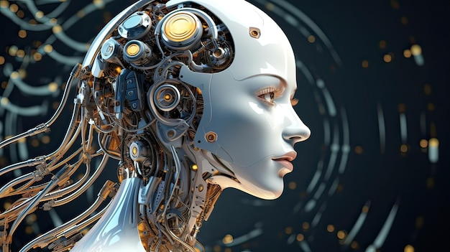
Upload Image Section
Users can drag and drop or browse images (JPG, JPEG, PNG).
Once uploaded, the image is displayed on the interface.

Slide 7
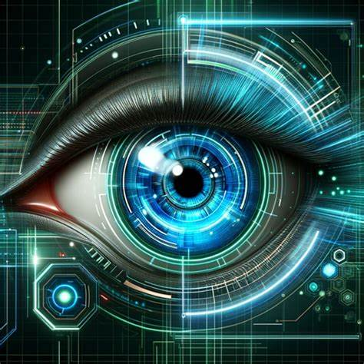
Scene Description Feature
Users can generate a detailed description of the image.
The system uses the Google Gemini API to analyze the image and generate the description.
The description includes items detected, their purpose, and overall image details.

Slide 8
Text Extraction Feature
Uses Tesseract OCR to extract text from the image.
Extracted text is displayed and can be downloaded as a .txt file.
Text-to-Speech Feature
Extracted text is converted into speech using pyttsx3.
The audio is played back to the user and can be downloaded as an .mp3 file.

Slide 9
Conclusion
VisionaryIQ helps visually impaired individuals interact with the world using AI-driven technologies.
Future enhancements can include multi-language support, faster processing, and deeper integrations with accessibility tools.
Allows a downloadable option in each task.

Slide 10

THANK YOU

